Slide 1

BANK CUSTOMER CHURN PREDICTION USING MACHINE LEARINING
SCHOOL OF ENGINEERING
DEPARTMENT OF INFORMATION TECHNOLOGY
By
J.VAMSHI– 227Z1A1224
M.ARUN KUMAR – 227Z1A1238
B.NAVADEEP– 237Z5A1202
Under the Guidance of
Mrs.S.RADHIKA – Assistant professor

Slide 2
CONTENTS
Problem Statement
Literature Survey
Existing System
Disadvantages
Proposed System
Advantages
Software and Hardware Requirements
Modules
System Architecture
UML Diagrams
Output
Testcases
Conclusion
Future Enhancement
References

Slide 3
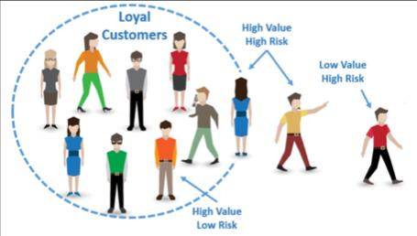
PROBLEM STATEMENT
Developing a model using Machine Learning to predict customer churn in the banking sector to help banks retain valuable clients and improve customer satisfaction.

Slide 4
LITERATURE SURVEY
Author(s) | Year | Summary | Advantages | Limitations
P. Rajalakshmi, N. Ramasubramanian | 2022 | Predicting bank customer churn using decision trees | Easy to understand model | Limited to small dataset
Shubham Sharma, Sandeep Kumar Verma | 2023 | Applied SVM for customer churn prediction in banks | High accuracy prediction | Not suitable for large data
P. Ranjani, V. Manogaran | 2022 | ML models for bank customer churn using ensemble | High performance models | Overfitting in some cases
Shilpa Mishra, S. S. Bhatia | 2021 | Used Random Forest for predicting churn in banks | Robust model performance | Limited data processing
Priyanka Kumari, R. K. Gupta | 2021 | Neural network approach for churn prediction | Accurate with large data | Computationally expensive

Slide 5
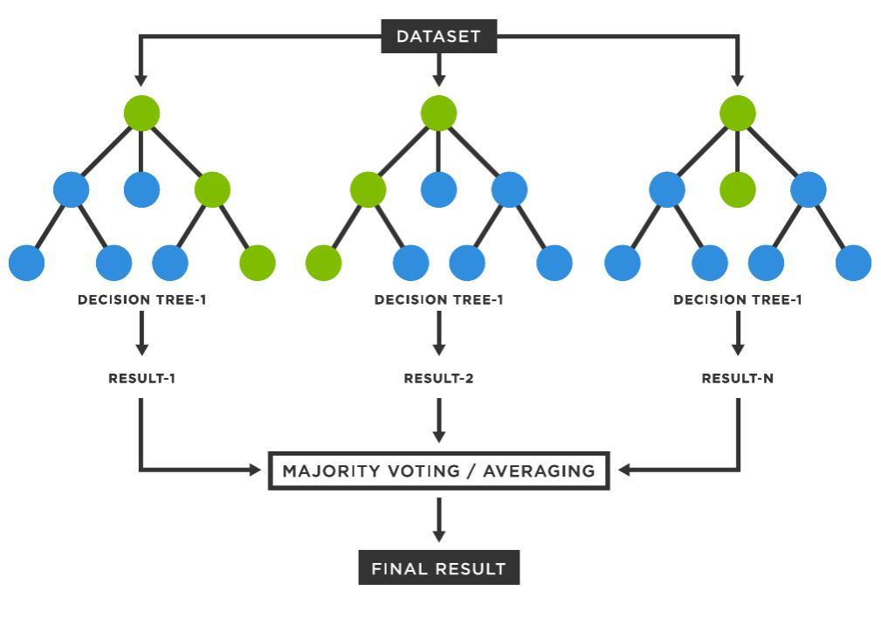
EXISTING SYSTEM
In the current system, the Random Forest Classifier is employed as the primary method for predicting customer churn. The Random Forest algorithm builds multiple decision trees and merges their results to improve predictive performance

Slide 6
DISADVANTAGES
Class imbalance issues.
Overfitting.
Performance with imbalanced data.
Computational Complexity.

Slide 7
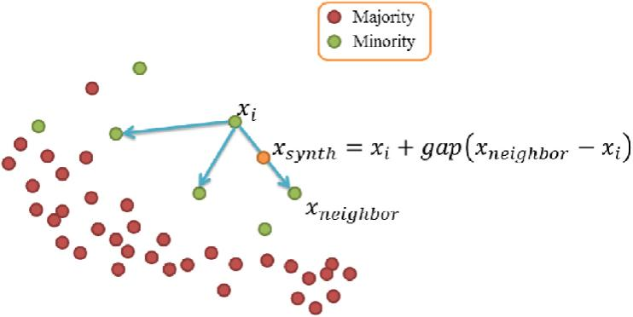
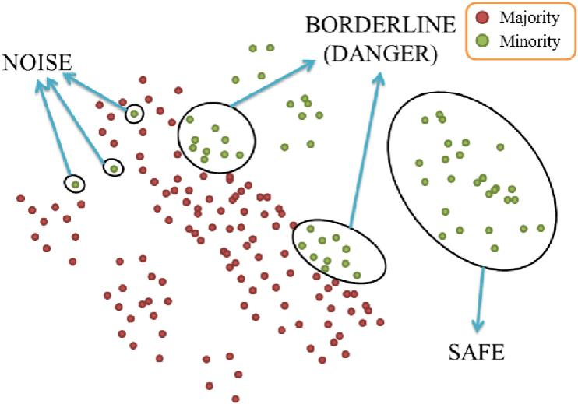
PROPOSED SYSTEM
The proposed system predicts bank customer churn using Gradient Boosting Machines (GBM) and Borderline-SMOTE to handle class imbalance. Key features include enhanced accuracy through synthetic sample generation for churned customers, improved prediction reliability via ensemble learning, and better generalization to unseen data.

Slide 8
ADVANTAGES
High predictive accuracy.
Handles Class imbalance.
Efficiently handles large dataset.
Reduces overfitting.

Slide 9
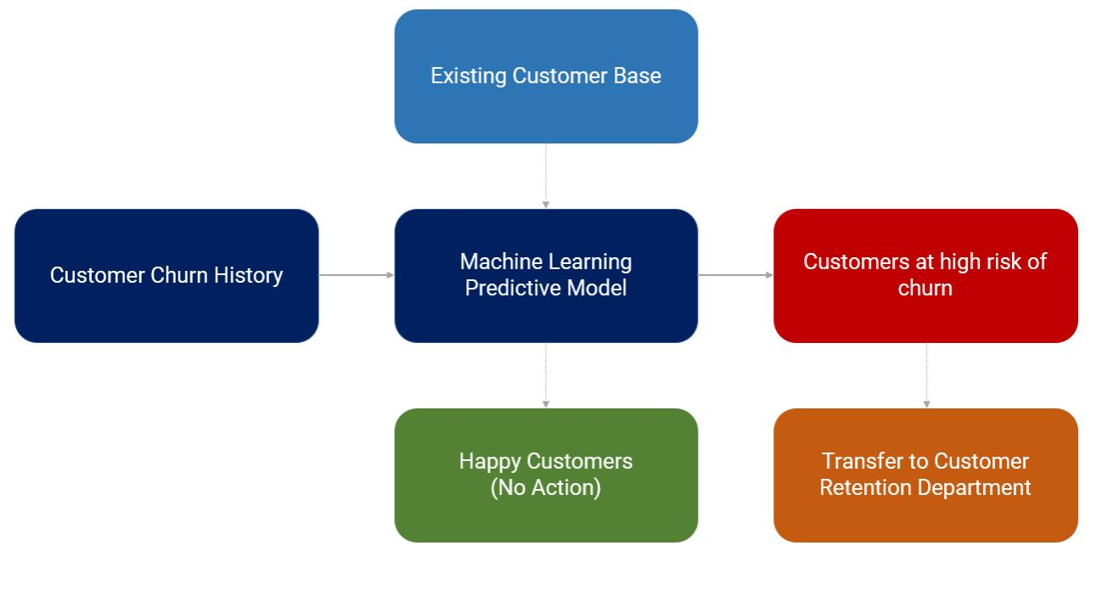
Block diagram of proposed system

Slide 10
SOFTWARE AND HARDWARE REQUIREMENTS
HARDWARE REQUIREMENTS
SOFTWARE REQUIREMENTS
Processor:i5 or i7
Hard Disk:120GB
RAM : Atleast 8GB
Operating System:Windows
Programming Language:Python
Tool: Visual Studio Code
Database:SQLite
Web Server:Flask

Slide 11
MODULES
DATA PREPROCESSING
Data preprocessing is a critical step in preparing the dataset for training and
evaluation of the machine learning model. This phase ensures that the data is
clean, relevant, and formatted appropriately to achieve the best performance
from the model.
Getting the dataset
Importing libraries
Importing datasets
Data Cleaning and Balancing
Splitting dataset into training and test set
Train the model
Test the model
Evaluate

Slide 12
MODULES
FUNCTIONAL MODULES:
Admin
Bank Employee
Bank Customer

Slide 13
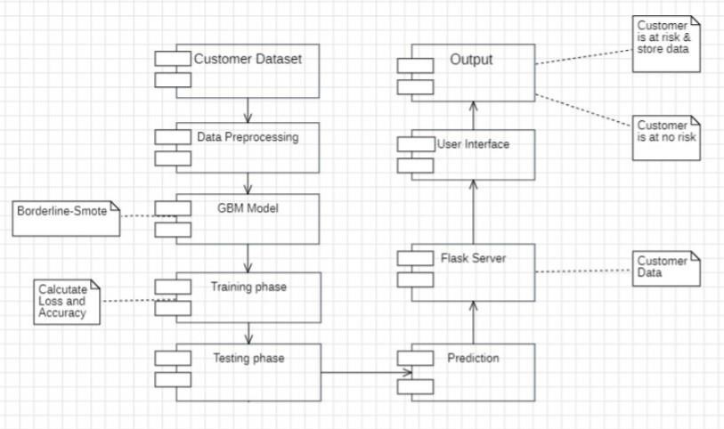
SYSTEM ARCHITECTURE

Slide 14
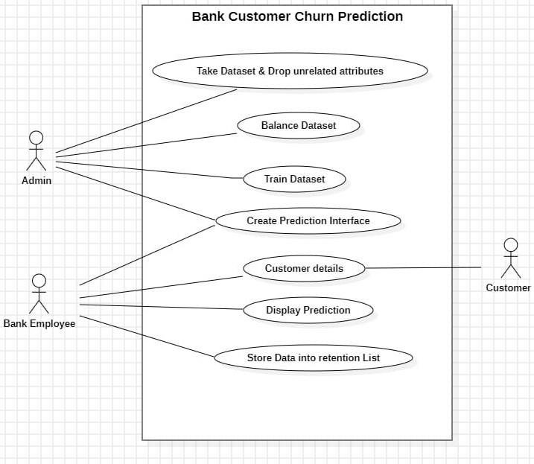
USE CASE DIAGRAM

Slide 15
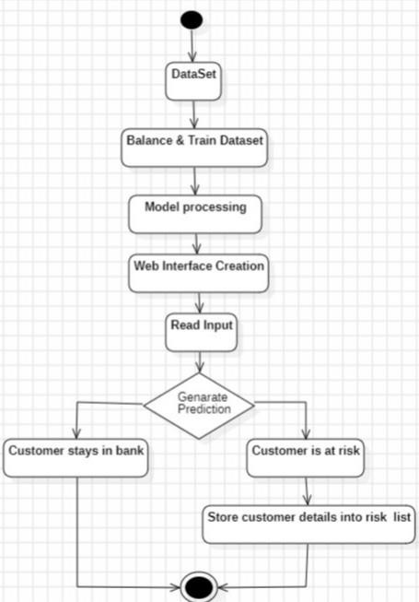
ACTIVITY DIAGRAM

Slide 16
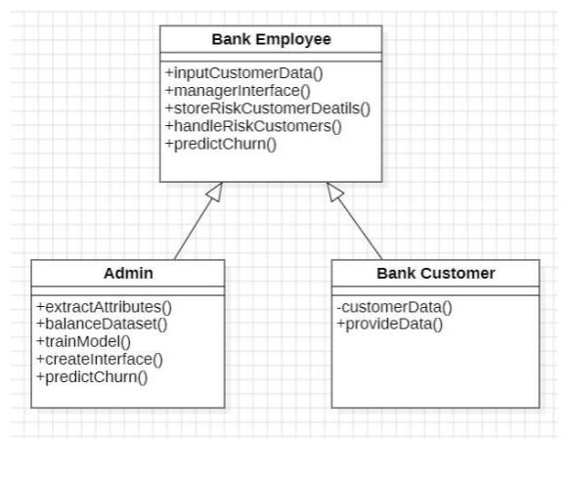
CLASS DIAGRAM

Slide 17
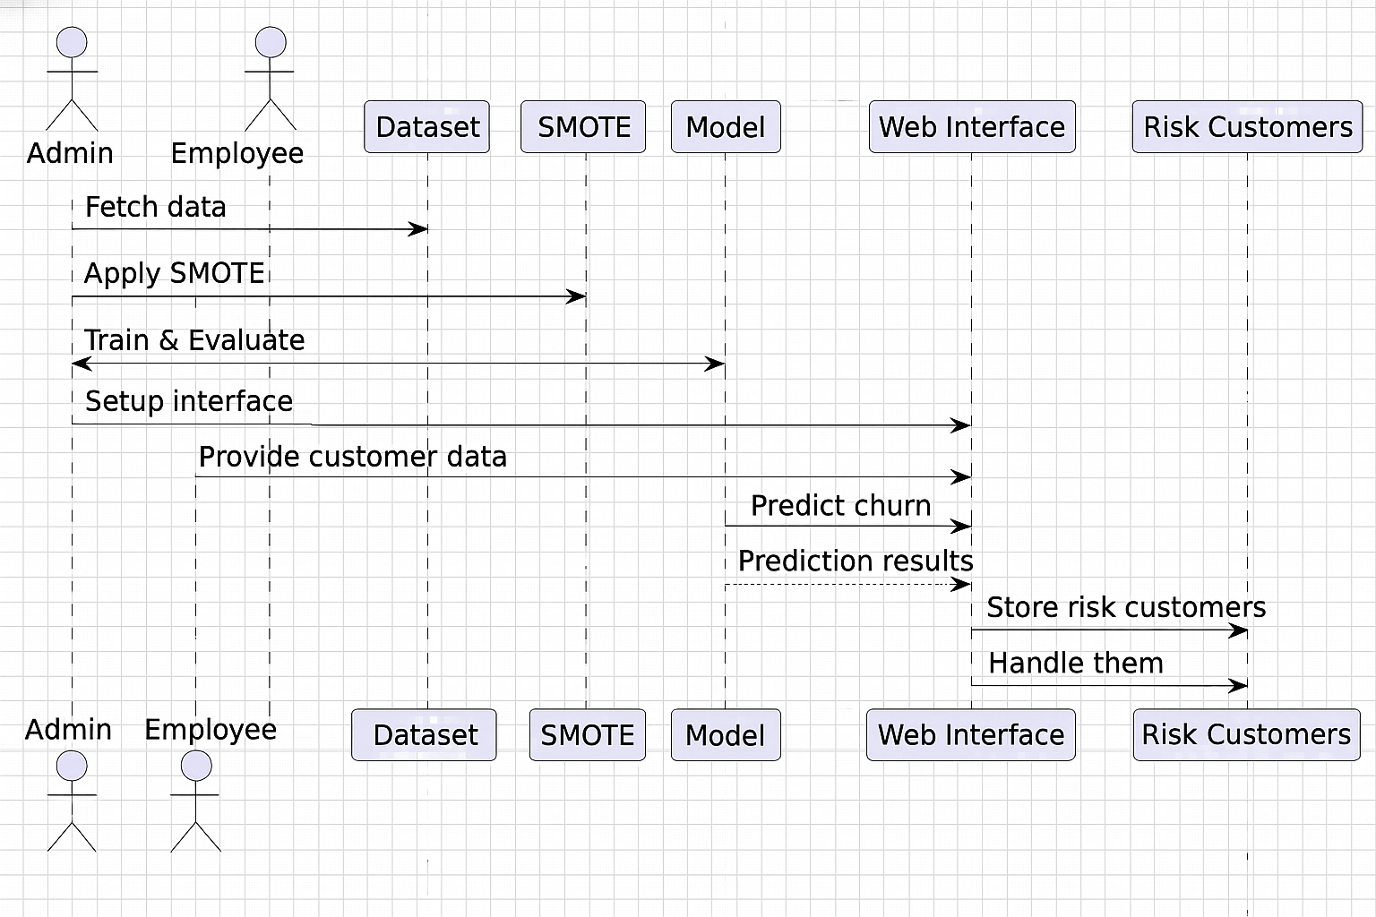
SEQUENCE DIAGRAM

Slide 18
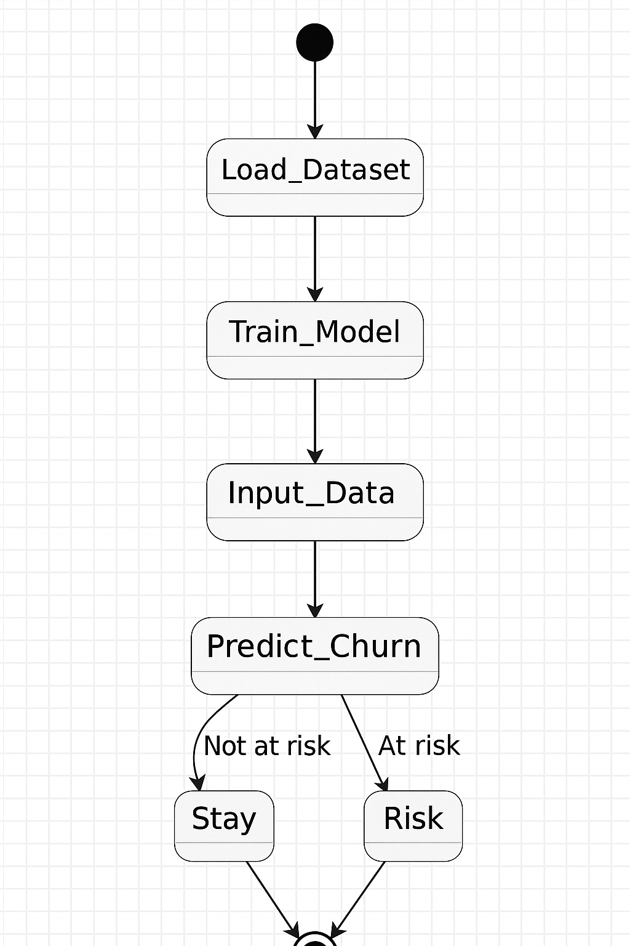
STATE CHART DIAGRAM

Slide 19
IMPORTING LIBRARIES
from flask import Flask, render_template, request, redirect, url_for, session, flash, send_file
from flask_mail import Mail, Message
import pandas as pd
import joblib
from sklearn.preprocessing import StandardScaler
from sklearn.preprocessing import StandardScaler
import sqlite3
import sqlite3
import random
import string
import os

Slide 20
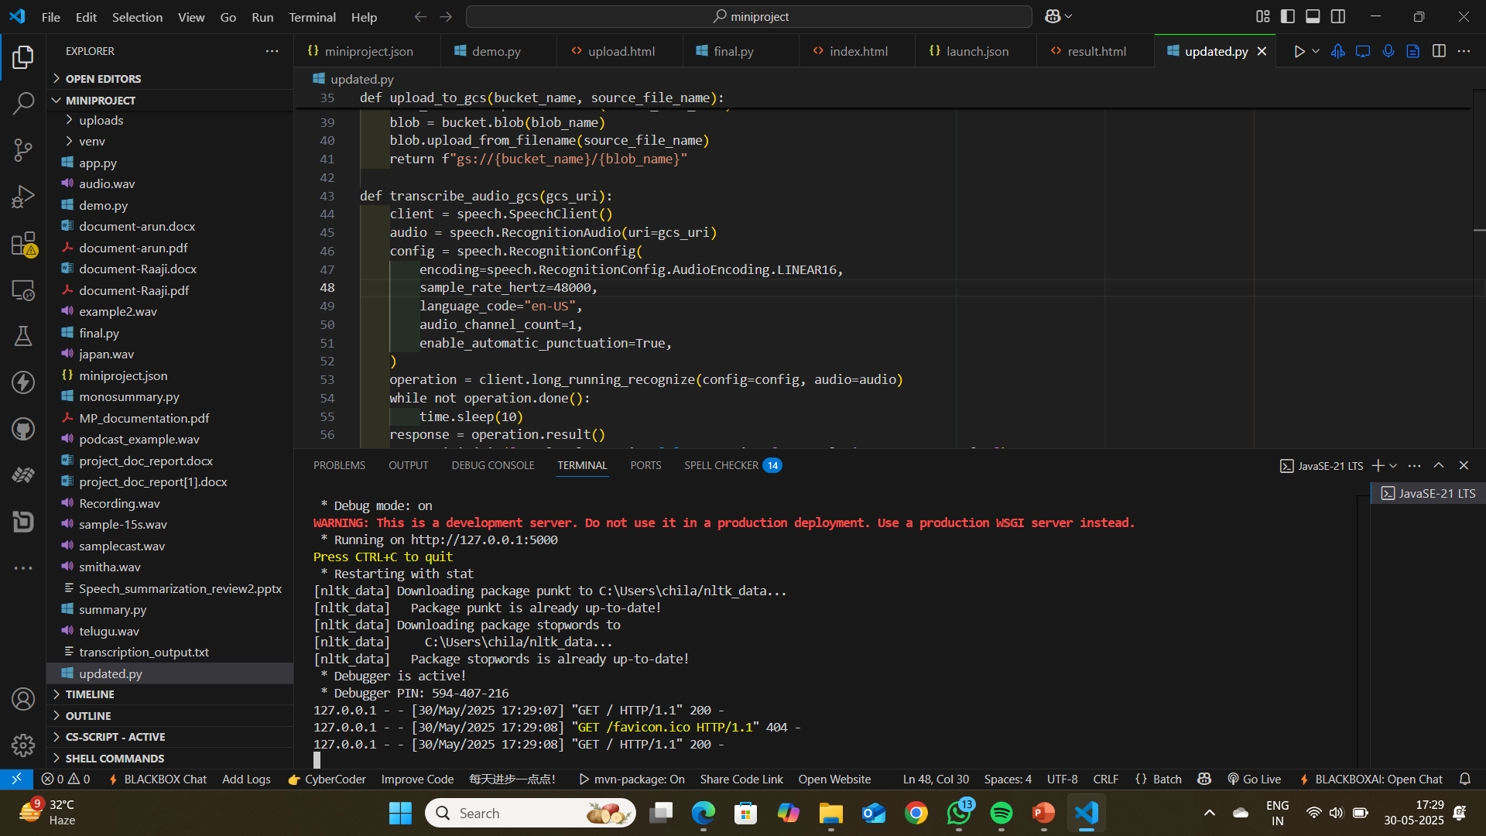
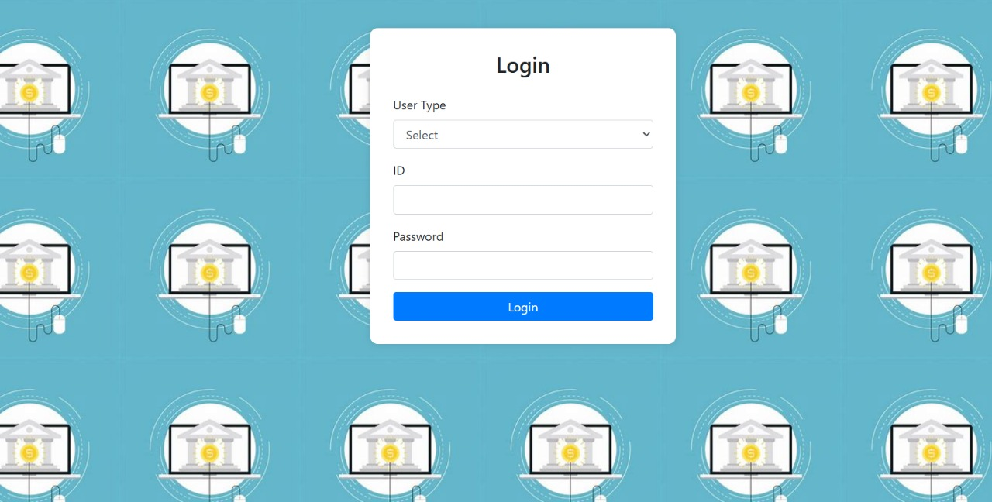
Output-
By executing program in python then it will prompt to a user Interface which is hosting by a local web. i.e Running on http://127.0.0.1:5000
Opens the User Interface and login with credentials.

Slide 21
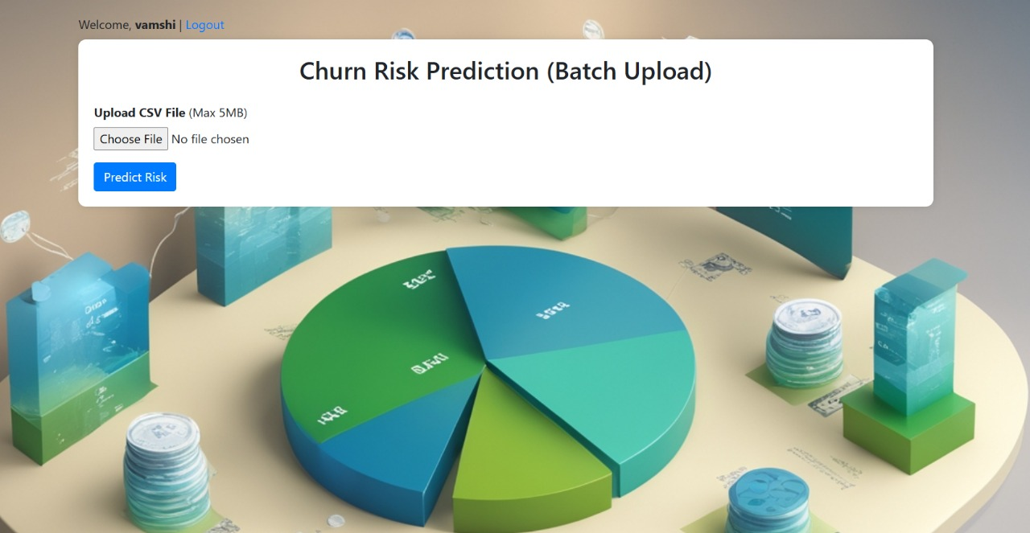
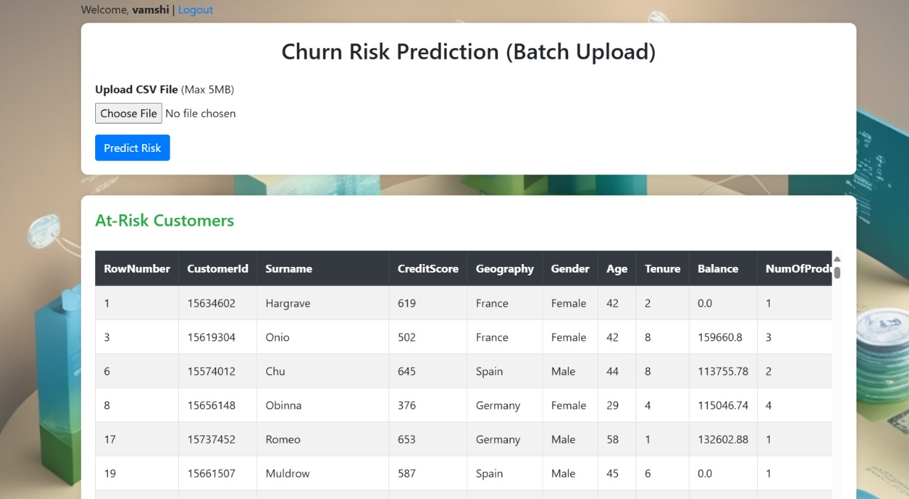
By clicking,choose file and predict risk…it will show list of risk customers

Slide 22
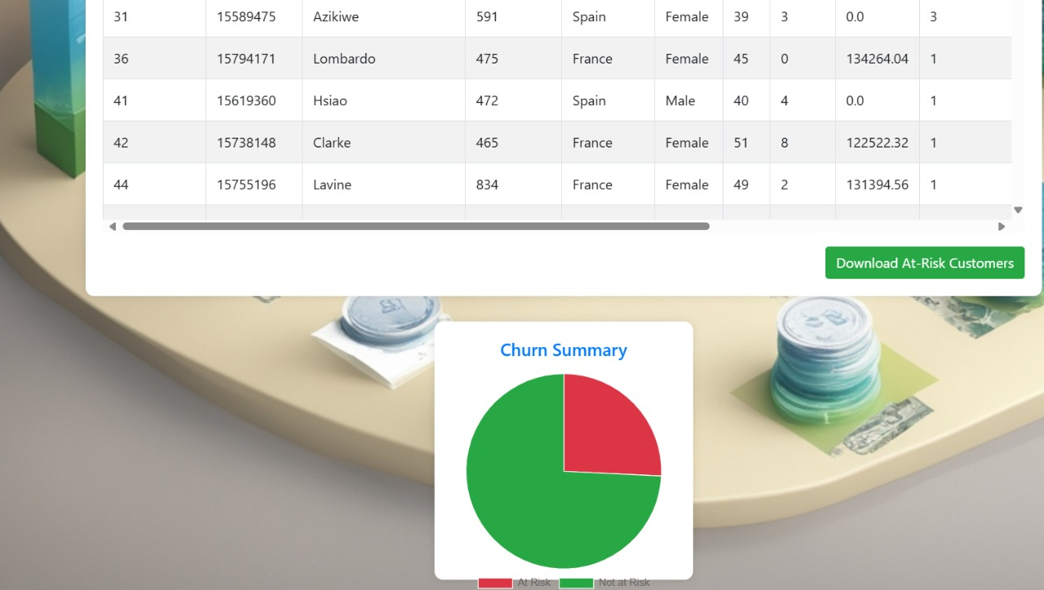
We can download the list by clicking,”Download At Risk-Customers” and Churn Summary is available

Slide 23
TESTCASES
TEST CASE ID | TEST CASE SCENARIO | INPUTS | EXPECTED OUTPUT | ACTUAL OUTPUT | STATUS
1 | Login with by giving id number and password | Enter id number and password | If given the credentials are correct, it should redirect to menu page or else you have to repeat the process. | The menu page is displayed successfully if the credentials are correct. | PASS
2 | On reaching menu page, need to upload csv with appropriate columns. | User has to upload a csv file. | Depending on the file available, need to upload | It will accept the csv file,if give with the condition less than 5MB. | PASS
3 | In menu page select Predict Risk. | Click the Predict Risk button to view the risk customers. | The risk customers will be visible on interface. | Risk customers will be predicted successfully. | PASS
4 | In menu page select Download Risk Customers to download file. | Click the download button to download the list. | Risk customers list will be download. | Risk customers list will be downloaded successfully. | PASS
5 | In menu page, select logout option | Say logout | The application should logout | Logged out successfully | PASS

Slide 24
CONCLUSION
Borderline-SMOTE handles class imbalance by creating synthetic samples near critical decision boundaries.
GBM builds a strong predictive model by correcting errors from previous trees.
High-risk customers are flagged for targeted retention, reducing churn and increasing bank profitability.

Slide 25
Future Enhancement
Advanced techniques like deep learning and real-time data processing can improve churn prediction accuracy and responsiveness.
External data integration (e.g., economic trends, social media sentiment) offers a broader view of churn drivers.
Explainability tools like SHAP enhance model transparency, building trust and aiding strategic decisions.

Slide 26
REFERENCES
Manas Rahman,V kumar,”Machine Learning Based Customer Churn Prediction in Banking”,Fourth International Conference on Electronics,Communication and Aerospace Technology (ICECA-2020)
T.Akshitha, P.Akshaya, M. Almomani, “Bank Customer Churn Prediction (IJRAR-2025)” .
R. Huang, Q. Zhao, S. Li, “Advanced Churn Prediction Model Using XGBoost and Feature Selection Techniques”, IEEE International Conference on Artificial Intelligence and Machine Learning (AIML), September 2021.

Slide 27

-
.

